Slide 1
Using SmartVault
Idaho Department of Juvenile Corrections
Information for IDJC County Partners
March 2022

Slide 2
The IDJC has changed how we receive information for juveniles committed to the department. We will work with you to make the transition as smooth, as possible.
Why?
A consistent, centralized process that is easy to use
Secure, web based, login based, accommodates large file size of 1 GB—unlike email
Early 2021, we transitioned to electronic submission by email but encountered issues related to file size limit
Resolve ongoing confusion about where to submit commitment orders and social/treatment history information
The majority of large and small counties are already using SmartVault successfully

Slide 3
Who? What?
Who: This resource is intended for use by county court and probation personnel
The IDJC is the “account administrator” that invites you to use SmartVault
Email ContactUs@idjc.Idaho.gov or call Estela Cabrera at 208.334.5100 to get set up
What: Use the SmartVault client portal to submit commitment orders and social history and treatment documents to the IDJC
For a review on submitting documents to the department, visit the IDJC website/About page at www.idjc.idaho.gov

Slide 4
Get an Account
You will need an email address and internet connection
The IDJC will create a dedicated Client Portal and invite you to use SmartVault
You can have one or more individual users or “Guests” that can access the portal
OR, you can use a general, shared mailbox avoiding interruptions when specific staff is unavailable or your agency experiences turnover
You will receive an email invitation with instructions to activate your account and create your SmartVault login

Slide 5
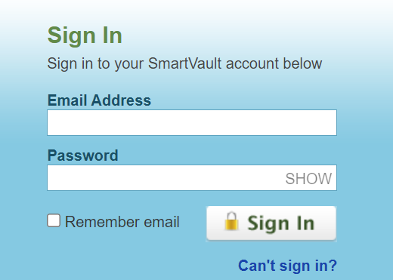
Login
Click this link to view a Client Portal Orientation
Much of the lingo will refer to accounting processes but the basic procedures on how to use the service still apply
Type this IP address in your browser https://my.smartvault.com/secure/SignIn.aspx
Using the Google Chrome browser seems to work best
Tip: Bookmark the SmartVault Sign In page for easy access to your client portal

Slide 6
Upload
Once your account is activated, you can access your client portal any time to upload files
Click the link for a short tutorial on how to upload files as a guest user
When uploading files, use the juvenile’s name in the file name
Use a consistent naming convention to organize or group the files. This is especially important when uploading files for more than one juvenile

Slide 7
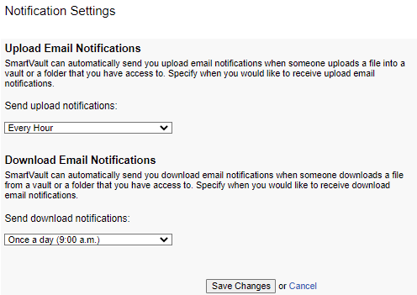
Notifications
You can set up upload and download notification preferences
SmartVault defaults to notifications once in a 24-hour period
Access “Notification Settings” to set your preference to what makes sense for you

Slide 8
Get Help
Use the SmartVault help feature
Open a chat session and get one-on-one help
Contact Estela Cabrera at 208.577.5451
Reach out to your JSC
Thank you for your partnership with the IDJC to serve Idaho families.

